Slide 1

Virtual Separation of Concerns
Photo (cc) Horia Varlan
Christian Kästner

Slide 2
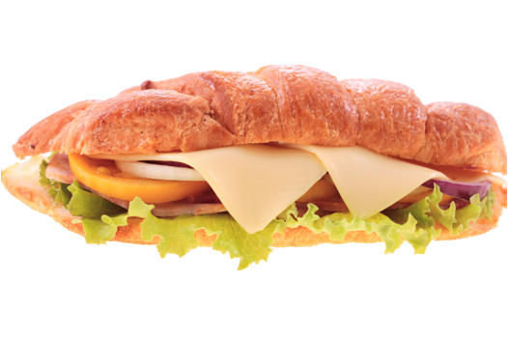

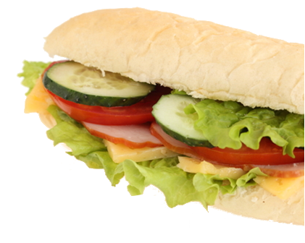
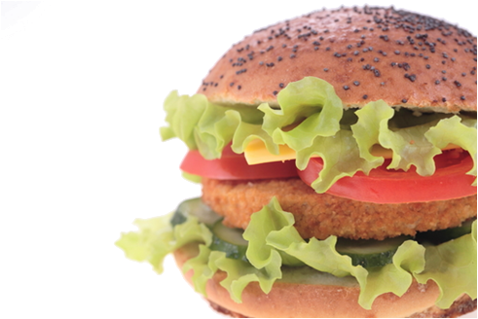

Slide 3
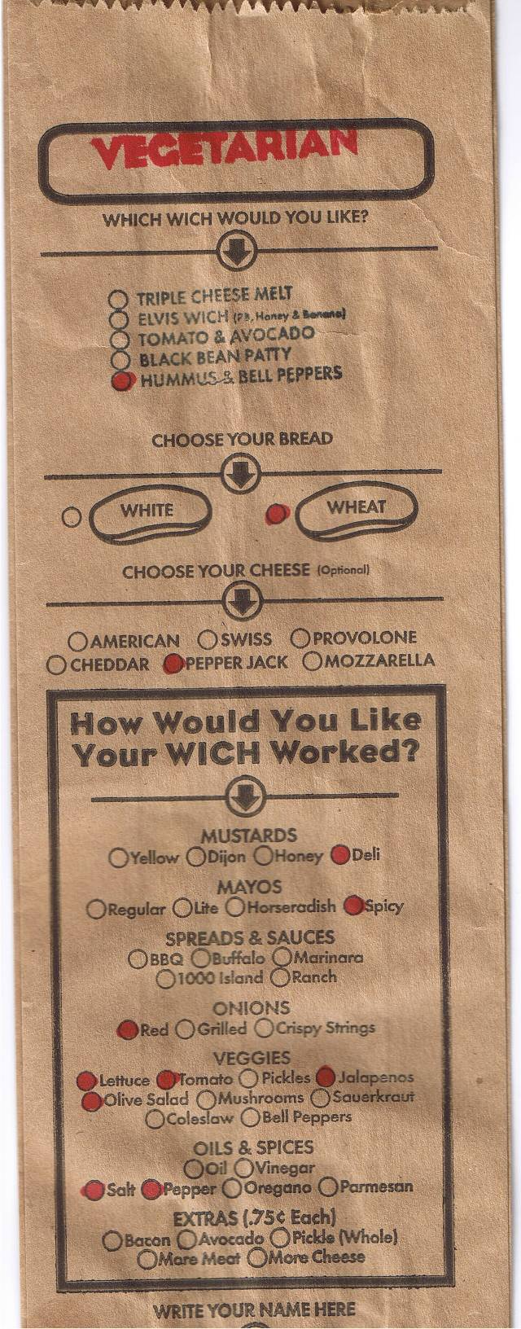
Feature-Oriented Product Lines

Slide 4
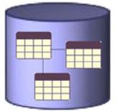



Database
Engine

Slide 5

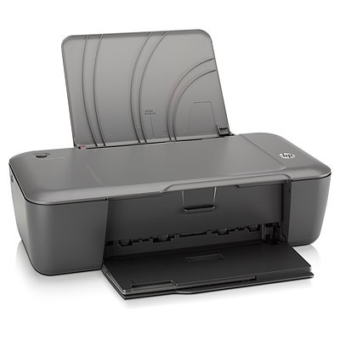
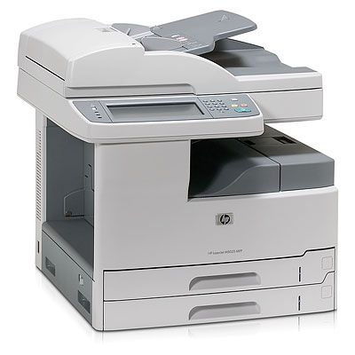
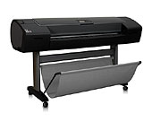
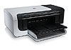
Printer Firmware

Slide 6


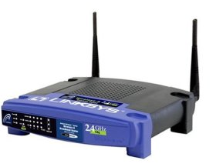
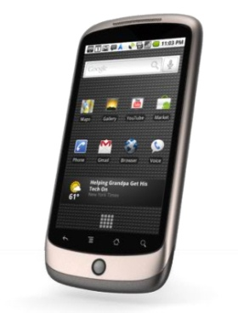
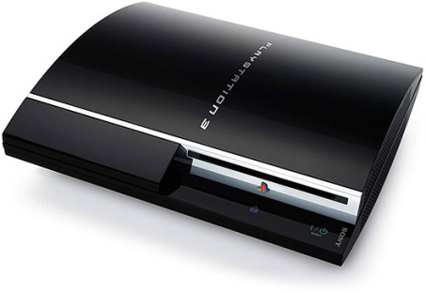
Linux
Kernel

Slide 7
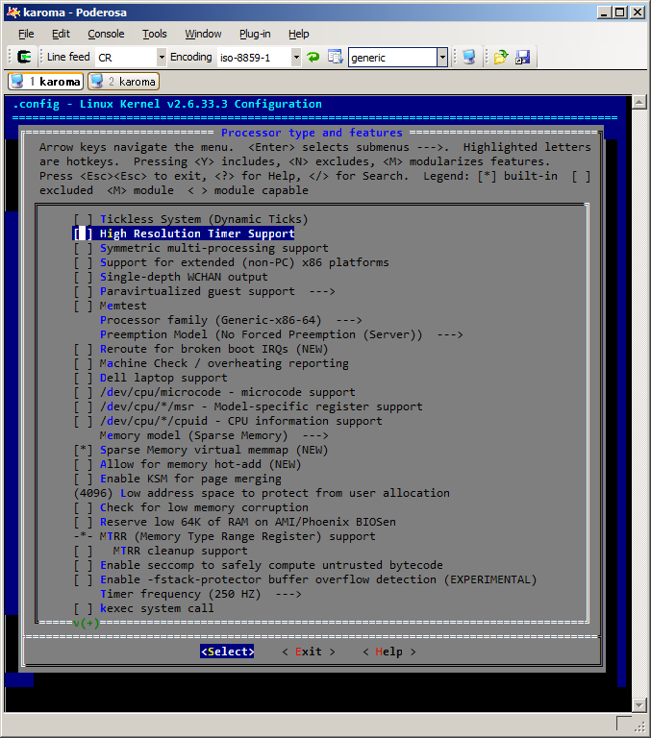

Slide 8

Variability = Complexity

Slide 9

33 features
optional, independent
a unique configuration for every
person on this planet

Slide 10

320 features
more configurations than estimated atoms in the universe
optional, independent

Slide 11
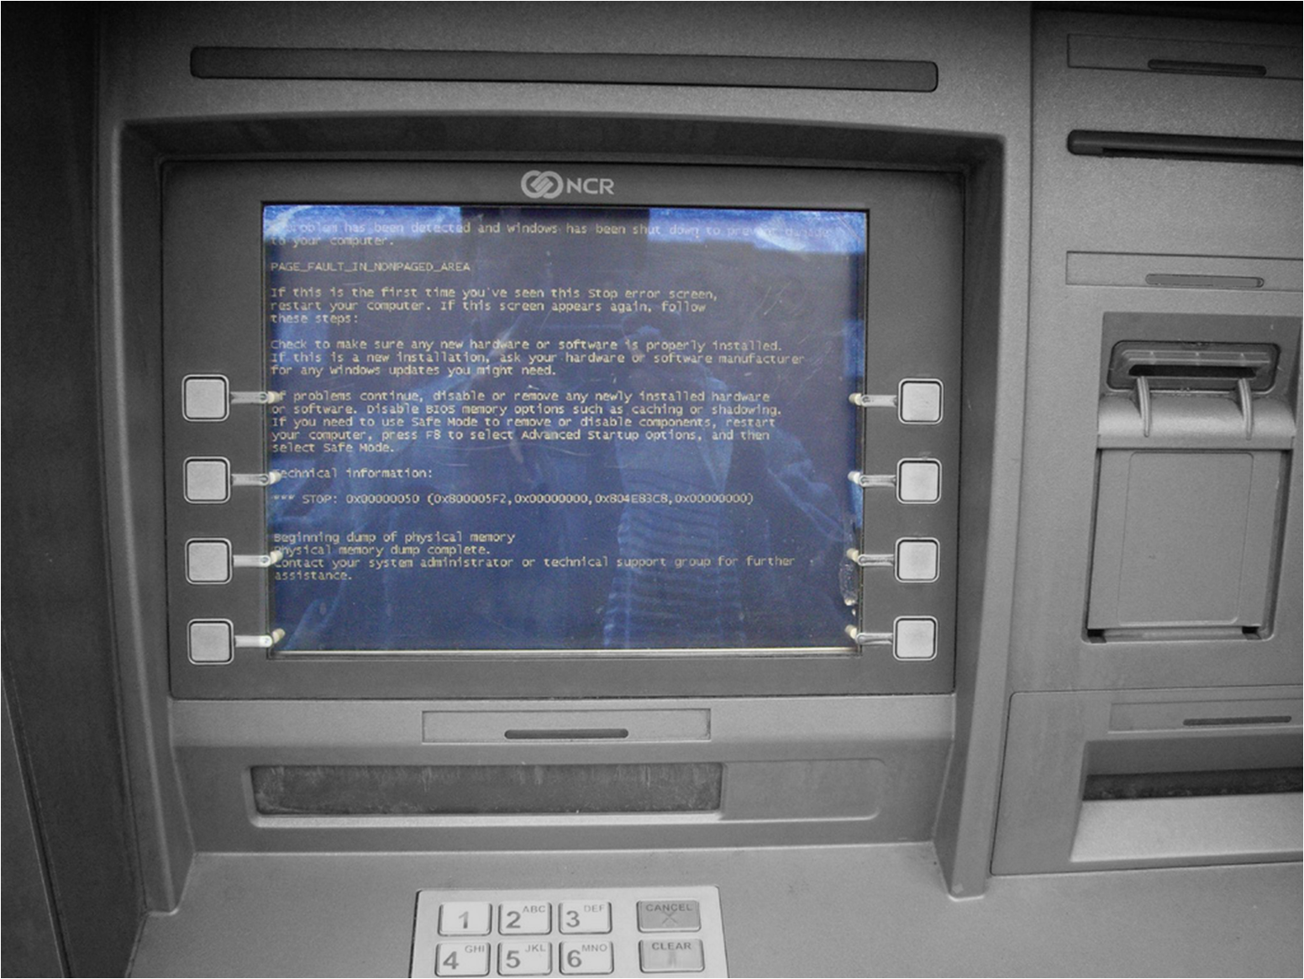
Correctness?

Slide 12
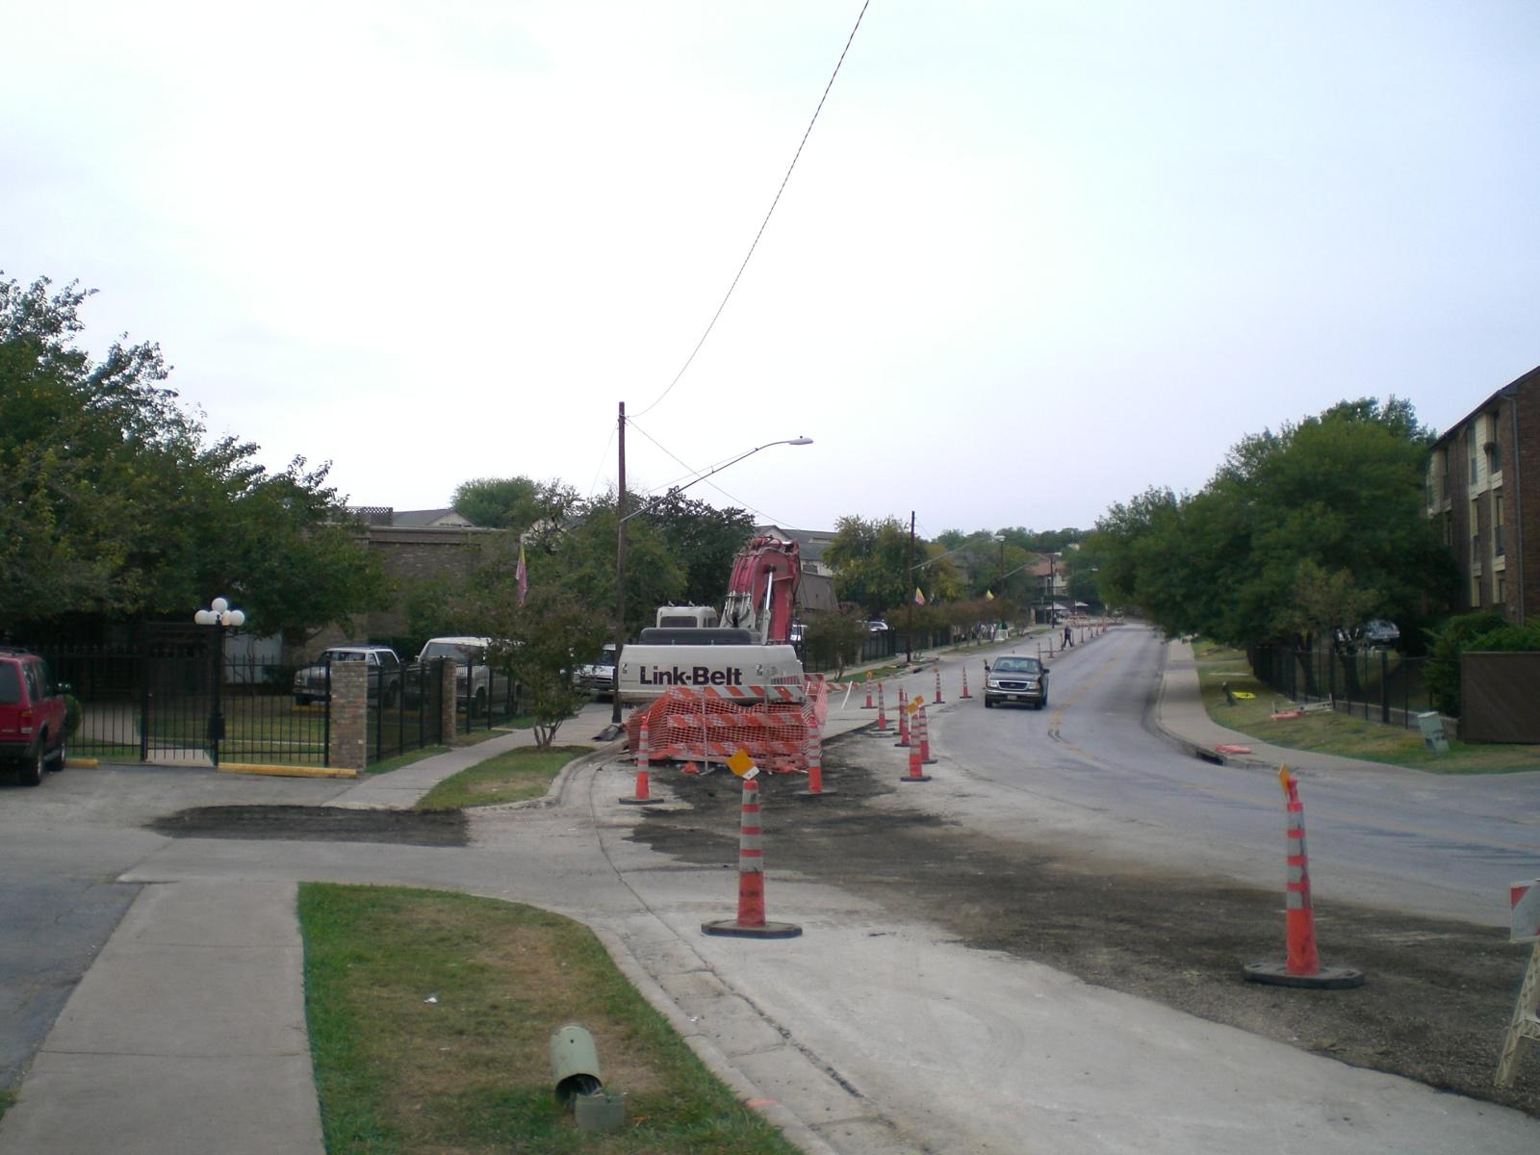
Maintenance?
Comprehension?

Slide 13
Conditional Compilation
static int _rep_queue_filedone(...)
DB_ENV *dbenv;
REP *rep;
__rep_fileinfo_args *rfp; {
#ifndef HAVE_QUEUE
COMPQUIET(rep, NULL);
COMPQUIET(rfp, NULL);
return (__db_no_queue_am(dbenv));
#else
db_pgno_t first, last;
u_int32_t flags;
int empty, ret, t_ret;
#ifdef DIAGNOSTIC
DB_MSGBUF mb;
#endif
...
Excerpt from Oracle’s Berkeley DB

Slide 14
Objections / Criticism
Designed in the 70th and hardly evolved since
“#ifdef considered harmful”
“#ifdef hell”
“maintenance becomes a ‘hit or miss’ process”
“is difficult to determine if the code being
viewed is actually compiled into the system”
“incomprehensible source texts”
“programming errors are easy
to make and difficult to detect”
“CPP makes maintenance difficult”
“source code rapidly
becomes a maze”
“preprocessor diagnostics are poor”

Slide 15
Academia: Compositional Approaches
Base / Platform
class Stack {
void push(Object o) {
elementData[size++] = o;
}
...
}
class Stack {
void push(Object o) {
Lock l = lock(o);
elementData[size++] = o;
l.unlock();
}
...
}
Feature: Queue
Composition
refines class Stack {
void push(Object o) {
Lock l = lock(o);
Super.push(o);
l.unlock();
}
...
}
Module
Components
Frameworks, Plug-ins
Feature-Modules / Mixin Layers / …
Aspects / Subjects, Hyper/J, Deltas
Feature: Diagnostic
aspect Diagnostics {
...
}
Notes:
Features implemented in distinct code units
Product generation by composing code
Common in academia
Great traceability – as in jigsaw picture before. Problem already solved ☺

Slide 16
A CLOSER LOOK AT Preprocessors

Slide 17
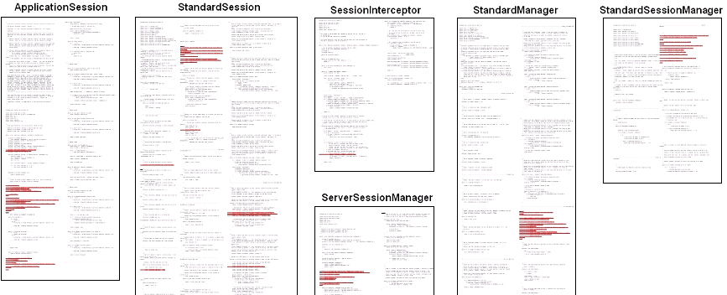
Separation of Concerns
Notes:
Scattered and tangled source code
Global search to understand a feature
Deleting obsolete feature as challenge
Difficult distributed development
Difficult reuse

Slide 18
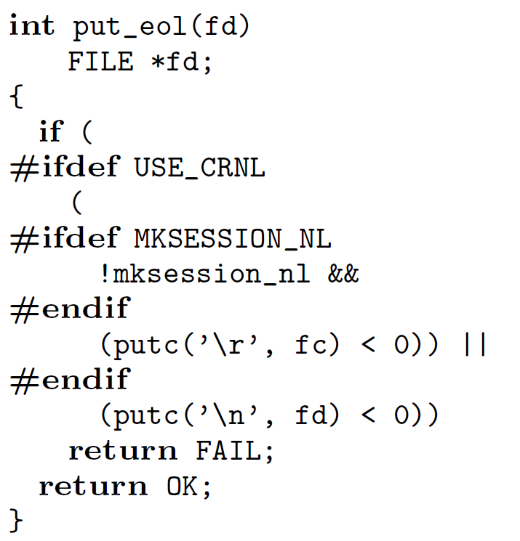
Obfuscation
class Stack {
void push(Object o
#ifdef SYNC
, Transaction txn
#endif
) {
if (o==null
#ifdef SYNC
|| txn==null
#endif
) return;
#ifdef SYNC
Lock l=txn.lock(o);
#endif
elementData[size++] = o;
#ifdef SYNC
l.unlock();
#endif
fireStackChanged();
}
}

Slide 19
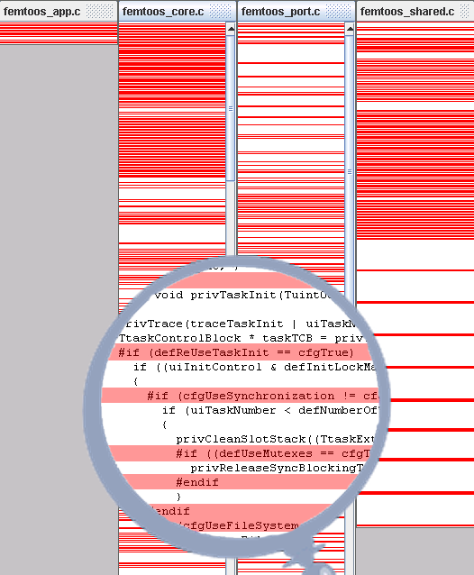
Obfuscation
Femto OS

Slide 20
Error-Prone
static int _rep_queue_filedone(...)
DB_ENV *dbenv;
REP *rep;
__rep_fileinfo_args *rfp; {
#ifndef HAVE_QUEUE
COMPQUIET(rep, NULL);
COMPQUIET(rfp, NULL);
return (__db_no_queue_am(dbenv));
#else
db_pgno_t first, last;
u_int32_t flags;
int empty, ret, t_ret;
#ifdef DIAGNOSTIC
DB_MSGBUF mb;
#endif
// over 100 lines of add. code
}
#endif
#ifdef TABLES
class Table {
void insert(Object data, Txn txn) {
storage.set(data, txn.getLock());
}
}
#endif
class Storage {
#ifdef WRITE
boolean set(…) { ... }
#endif
}

Slide 21
Advantages
Easy to use
“annotate and remove”
Already part of many languages / simple tools
Most developers already familiar
Flexible / Expressive
Language-independent / Uniform
Low Adoption Barrier
esp. with legacy code

Slide 22
Improving Tool Support

Slide 23
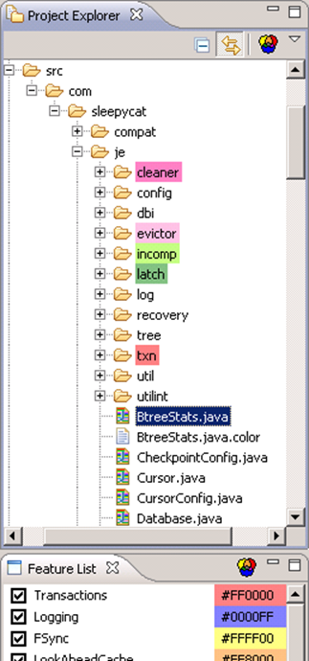
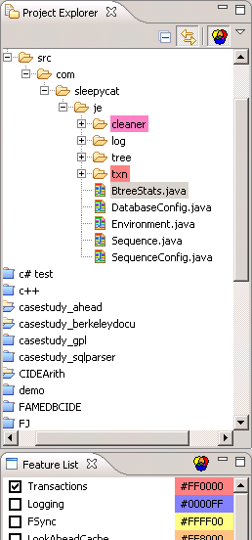
Views
[ICSE’08, ViSPLE’08]

Slide 25
View on Feature Eval

Slide 26
View on Configuration “Add and Eval”

Slide 27
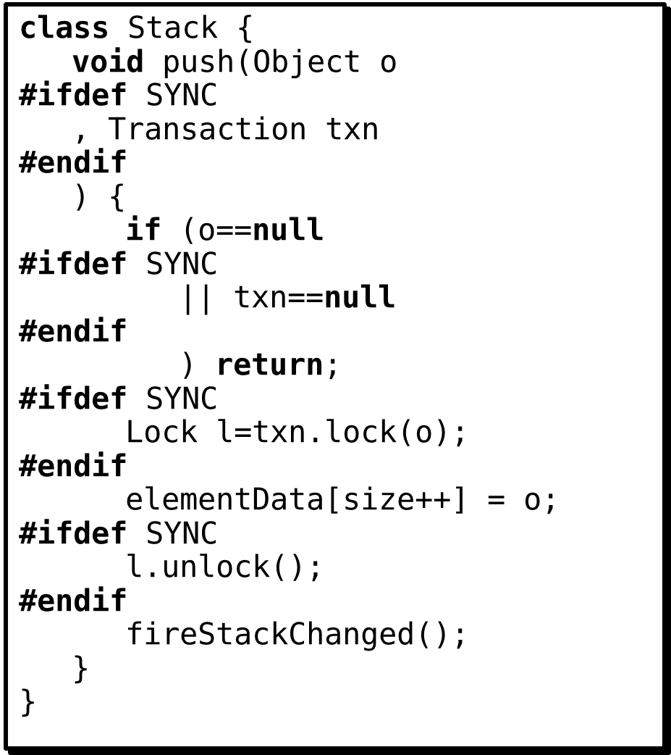
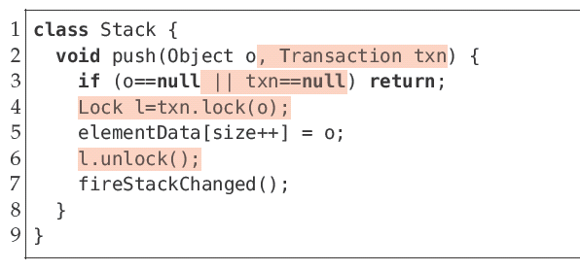
[ICSE’08, ICSE‘10, EASE‘11]

Slide 28
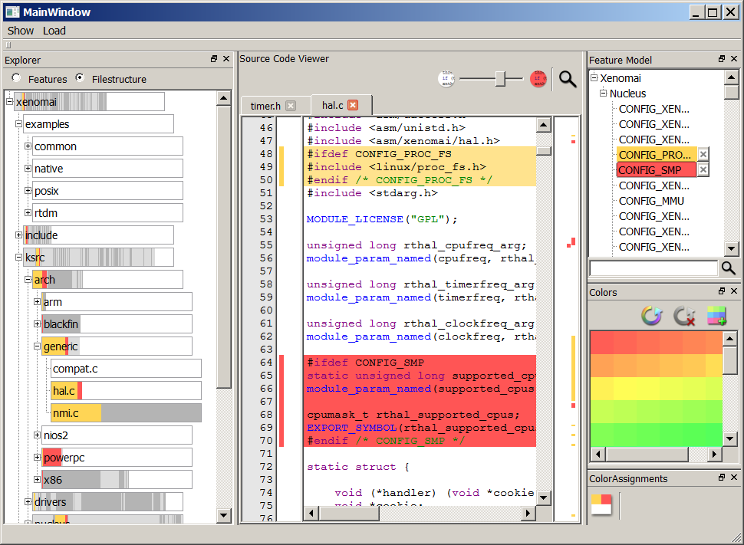
FeatureCommander

Slide 29
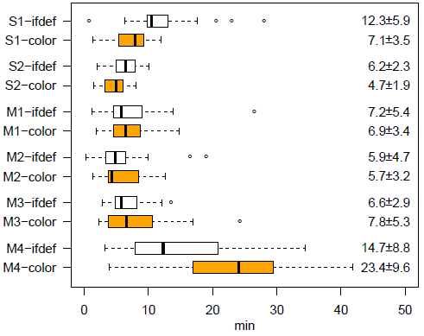
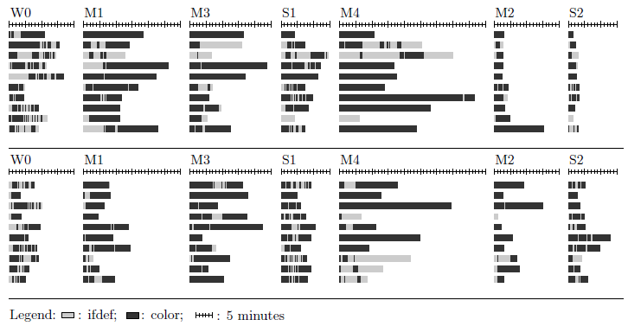
Controlled Experiments
3
Faster?
Scaling?
How Used?

Slide 30
Error Detection / Prevention

Slide 31
Disciplined
Annotations
#ifdef WORLD
int main() {
printf(“Hello World”);
}
#endif
int main() {
#ifdef WORLD
printf(“Hello World”);
#endif
}
greet.c
Align with variability model
printf
V_{WORLD}
V_{BYE}
main
msg
ε
msg
ε
printf
Align with code structure
msg

Slide 32
Disciplined
Undisciplined
Annotations
#ifdef WORLD
int main() {
printf(“Hello World”);
}
#endif
int main() {
#ifdef DYNAMIC
if (enabled) {
#endif
printf(“Hello World”);
#ifdef DYNAIC
}
#endif
}
int main() {
#ifdef WORLD
printf(“Hello World”);
#endif
}
int a =
#ifdef DYNAMIC
enabled? 3 : 4 +
#endif
5;
Align with variability model
Align with code structure

Slide 33
static int _rep_queue_filedone(...)
DB_ENV *dbenv;
REP *rep;
__rep_fileinfo_args *rfp; {
#ifndef HAVE_QUEUE
COMPQUIET(rep, NULL);
COMPQUIET(rfp, NULL);
return (__db_no_queue_am(dbenv));
#else
db_pgno_t first, last;
u_int32_t flags;
int empty, ret, t_ret;
#ifdef DIAGNOSTIC
DB_MSGBUF mb;
#endif
// over 100 lines of add. code
}
#endif

Slide 34

Variability-Aware
Parser
Type System
Static Analysis
Bug Finding
Testing
Model Checking
Theorem Proving
…

Slide 35
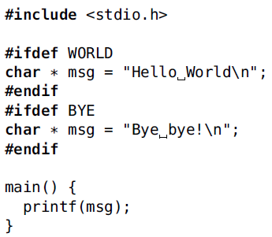

Slide 36
Conflicts
References

Slide 37
true
WORLD
Presence Conditions
BYE
true

Slide 38

Reachability: pc(caller) -> pc(target)
Conflicts: ¬(pc(def1) ˄ pc(def2))
¬ (WORLD ˄ BYE)
true -> (WORLD v BYE)
true -> true

Slide 39
Variability Model:
P
WORLD
BYE
VM ->¬ (WORLD ˄ BYE)
VM -> (true -> (WORLD v BYE))
VM -> (true -> true)

Slide 40
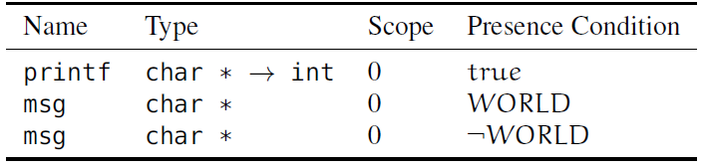
AST with Variability Information
greet.c
true -> true
…
printf
V_{WORLD}
V_{BYE}
main
msg
ε
msg
ε
printf
¬ (WORLD ˄ BYE)
msg
true -> (WORLD v BYE)
WORLD
BYE
Extended Lookup Mechanism

Slide 41

Formalization: CFJ
[ASE’08, TOSEM‘11]

Slide 42
Handling Complexity
Surface Complexity
Inherent
Complexity
SAT
Problem

Slide 43
Variability-Aware Analysis
Type System
Static Analysis
Bug Finding
Testing
Model Checking
Theorem Proving
…

Slide 44
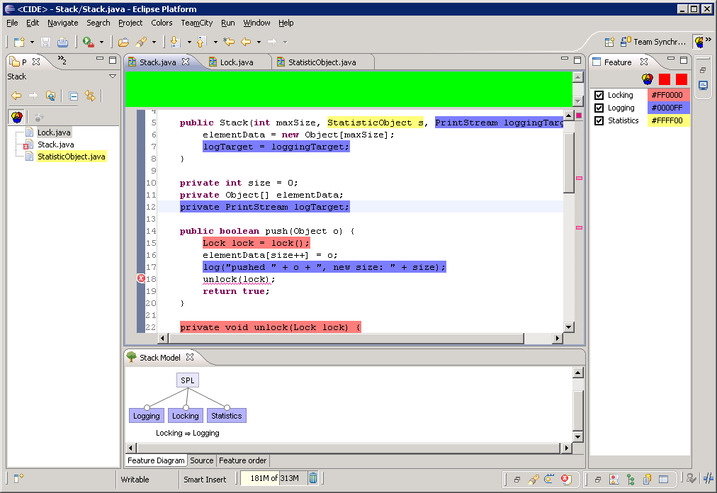
CIDE
open source, fosd.net/cide
http://fosd.de/cide

Slide 45
Automated Refactorings
[GPCE’09]
Feature Module
Annotationen
class Stack {
int[] data;
void push(int o) { … }
int pop() { /*...*/ }
}
class Stack {
int[] data;
#ifdef UNDO
int backup;
void undo() { /*...*/ }
#endif
#ifdef TOP
int top() { /*...*/ }
#endif
void push(int o) {
#ifdef UNDO
backup = top();
#endif
/*...*/
}
int pop() { /*...*/ }
}
Base
refines class Stack {
int top() { /*...*/ }
}
Automated Transformation
Top
refines class Stack {
int backup;
void undo() { /*...*/ }
void push(int o) {
backup = top();
original(v);
}
}
Undo

Slide 46
The Real-World Challenge

Slide 47

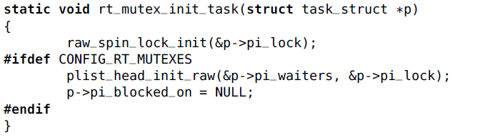
Parse and Type check
all configurations of the
entire Linux kernel
TypeChef
10,000 features, 6 million lines of C code

Slide 48
[OOPSLA‘11]
Variability-Aware Parsing
greet.c
…
printf
V_{WORLD}
V_{BYE}
main
msg
ε
msg
ε
printf
msg
AST with Variability Information

Slide 49
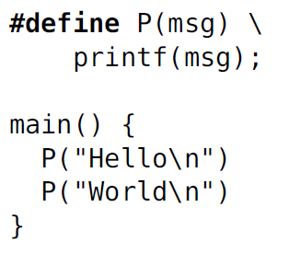
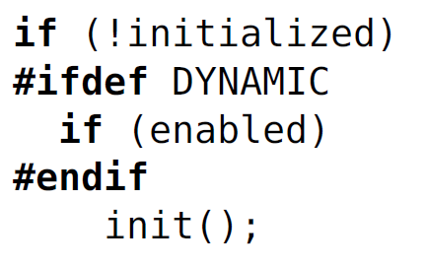
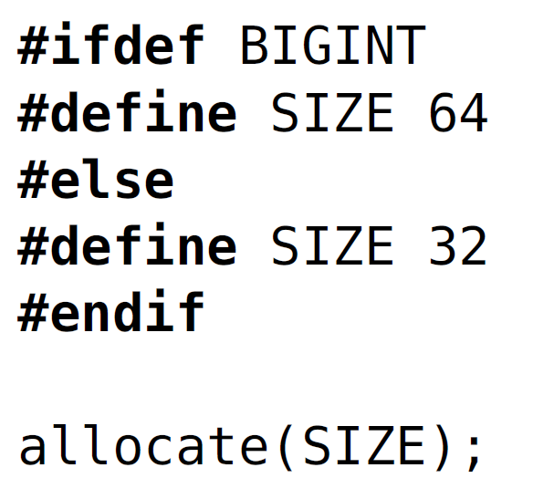
Undisciplined
annotations
Macro expansion
needed for parsing
Alternative macros
?
?
?
greet.c
+ printf
V_{WORLD}
V_{BYE}
+ main
+ msg
ε
+ msg
ε
printf
msg

Slide 50

Parsing C
without Preprocessing

Slide 51




Slide 52


Previous Solutions
Disciplined Subset
Requires Code Preparation
Heuristics and Partial Analysis
Inaccurate, False Positives
Brute Force
Infeasible Effort

Slide 53
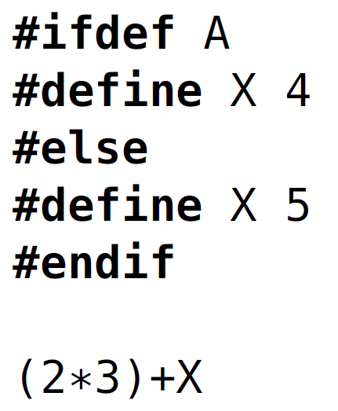
TypeChef
(
+
2
Variability-Aware
Lexer
*
Variability-Aware
Parser
3
*
V_{A}
)
+
4_{A}
2
3
4
5
5_{¬A}
Variability-Aware
Analysis
https://github.com/ckaestne/TypeChef

Slide 54
4_{A}
(_{¬A}
4_{¬A˄B}
+_{¬A˄B}
6_{¬A}
)_{¬A}
true
(
3
+
)
4_{¬A˄B}
+_{¬A˄B}
6_{¬A}
+
4_{A}
(_{¬A}
)_{¬A}
3
V_{A}
4_{¬A˄B}
+_{¬A˄B}
6_{¬A}
4
V_{B}
+
6
4
6

Slide 55
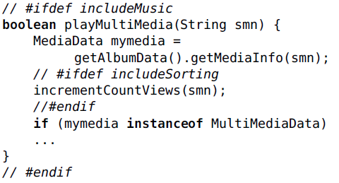


Variability-Aware Parsers
GNU C + cpp
Java + Antenna

Slide 56
Parsing Linux
Variability in Build System (kbuild) and with #ifdef
Variability Model (kconfig)
2.6.33.3
X86

Slide 57
353
8590
1387
340
335490
72
0 included header files per C file
0 macros per C file
0 conditional macros per C file
0 alternative macros per C file
0 token per C file
0 % conditional
2.6.33.3
X86

Slide 58
7665
30
85
4.1
0
0 C files (x86)
0 seconds per file (median)
0 hours total
0 % overhead (undiscipl.)
0
0 syntax errors
2.6.33.3
X86

Slide 59
Type Checking Linux
Work in Progress
2.6.33.3
X86

Slide 60
Summary and Perspective

Slide 61
Summary
Problems:
Separation of Concerns
Obfuscation
Error-proneness
Retained advantages:
Easy to use
Flexible
Language-independent
Low adoption barrier
Improvements:
Views
Visual representation
Variability-aware analysis
Remaining Problems:
Modular Type Checking
Separate Compilation
Black-box Reuse
“Virtual Separation of Concerns”

Slide 62

Perspective
Preprocessors common in practice, despite criticism
Neglected by researchers
Tool support can address most problems
Currently scaling to Linux
Interim solution or serious alternative?
Give preprocessors a second chance!

Slide 63
Questions?
http://fosd.de/cide

Slide 64


Picture Credits
© Stuck in Customs (cc by-nc-sa 2.0)
© Horia Varlan (cc by 2.0)

